Slide 1
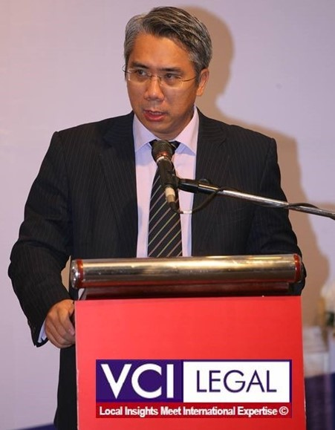
Proudly introduce
Proudly introduce
Prominent Speaker
PHUNG ANH TUAN ESQ.
VCI LEGAL | Managing Partner
VAFI | Vice-Chairman and General Secretary
Prominent Speaker

Slide 2
Proudly introduce
PHUNG ANH TUAN ESQ.
VCI LEGAL | Managing Partner
VAFI | Vice-Chairman and General Secretary
Prominent Speaker
Prominent Speaker

Slide 3
Proudly introduce
Proudly introduce
Prominent Speaker
PHUNG ANH TUAN ESQ.
VCI LEGAL | Managing Partner
VAFI | Vice-Chairman and General Secretary
Prominent Speaker

